Slide 1




Centauri:
Enabling Efficient Scheduling for Communication-Computation Overlap in Large Model Training via Communication Partitioning
Chang Chen†, Xiuhong Li†, Qianchao Zhu†, Jiangfei Duan∗, Peng Sun§, Xingcheng Zhang§, Chao Yang†
charlie_chen@pku.edu.cn
† Peking University, ∗ The Chinese University of Hong Kong, § Shanghai AI Lab

Slide 2
First, what is a good communication?
In distributed LLM tasks, minimizing communication overheads is good,
but making communication imperceptible (overlapped) is even better.

Slide 3
Background
Original
Task
Direct
Scheduling
Kernel
Fusion
Centauri
Partition &
Scheduling

Slide 4
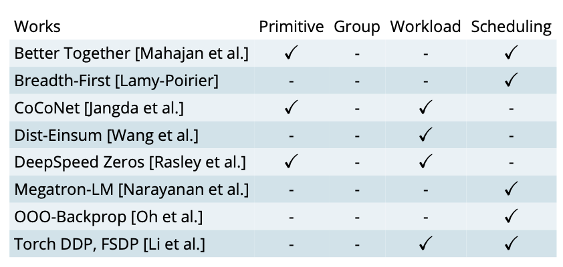
Challenges and Key Insights
Challenge 1: How to systematically explore the overlapping space?
Insight: Communication inherently is a mapping transformation (primitive) of workload across a group of devices.
Primitive, group, and workload are the “basis” of overlapping space naturally.

Slide 5
Challenges and Key Insights
Challenge 2: How to efficiently schedule the partitioned task?
Insight: Training tasks have the nature of a hierarchical structure.
e.g., tiers of
1) operation, 2) layer, and 3) model in training tasks
operation
layer
model

Slide 6
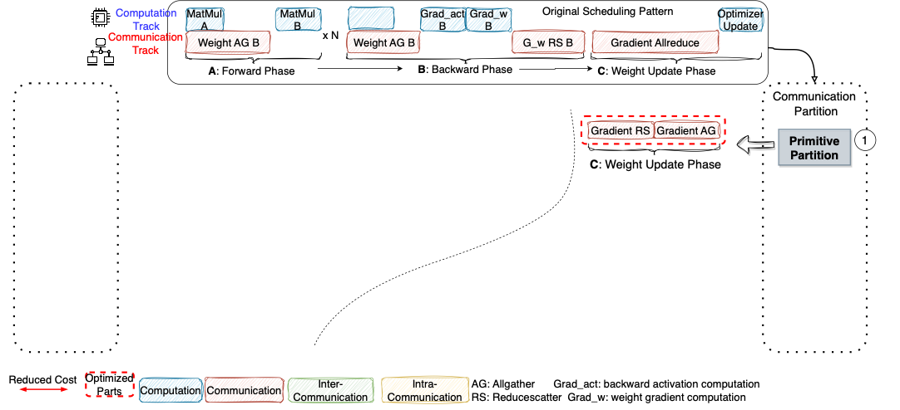
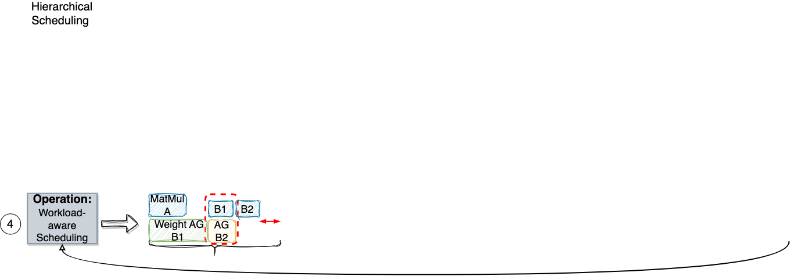
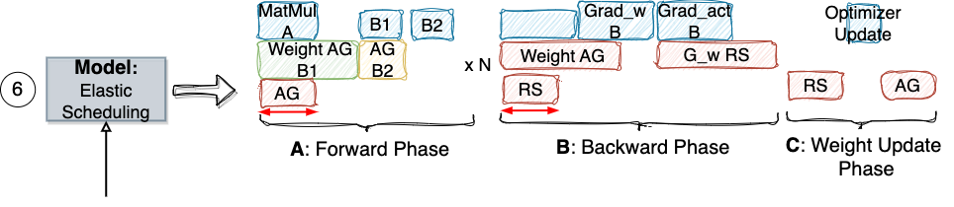
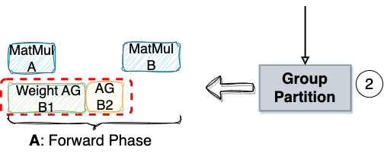
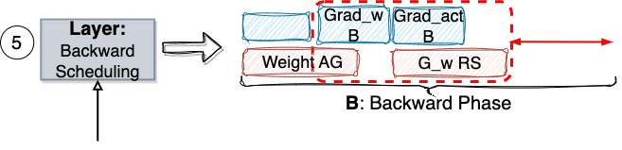
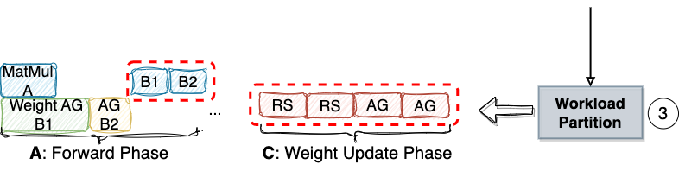
Centauri-Overview

Slide 7
Centauri-Primitive Partition
Example 1: Allreduce = Reduce-scatter + Allgather
Example 2: Reduce-scatter = Reduce + Scatter

Slide 8
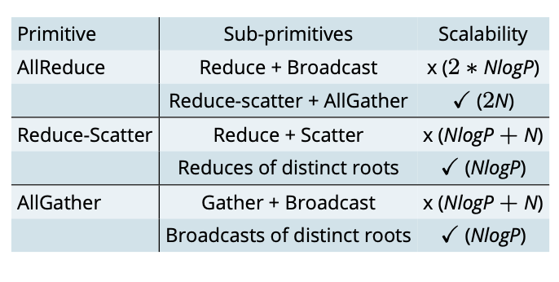
Centauri-Primitive Partition
*
Takeaway:
Performance scalability is essential in primitive substitution.
An interesting observation of SP and Zero-1,2.
Typical Bandwith Latency on Ring Topology and Tree Topology;
N is workload; P is group size.

Slide 9
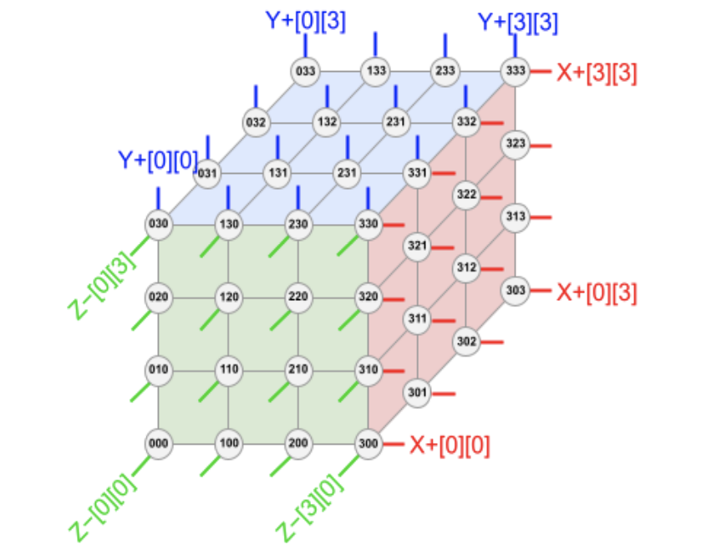
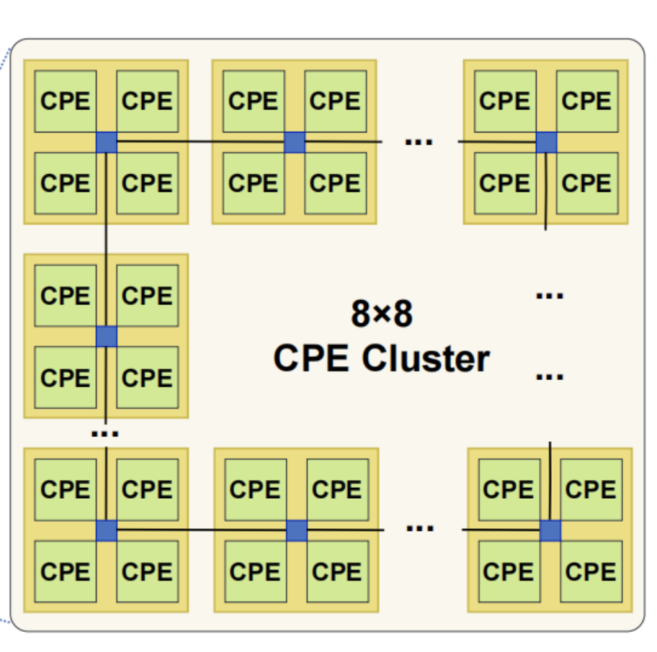
Centauri-Group Partition
Sunway Super Computer
SW26010-Pro [Zhu et al.]
– 2D mesh
TPUv4 [Jouppi et al.]
– 3D Cube
GPU Cluster - Ring
GPU Cluster – 2D Tree
Takeaway:
High-dimension topology awareness is essential in group paritioning.

Slide 10
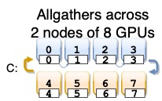
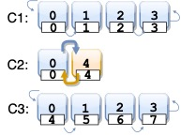
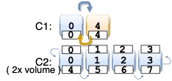

Centauri-Group Partition
+
+
+
+
(1) Original Allgather
(2) Inter-node Allgather
+
Intra-node Allgather
(3) Intra-node Allgather
+
Inter-node Allgather
(4) Intra-node Allgather
+
Inter-node Allgather
+
Intra-node Allgather
Examples: 4 allgather group partitioning methods of different scheduling, from the perspective of rank 0.

Slide 11
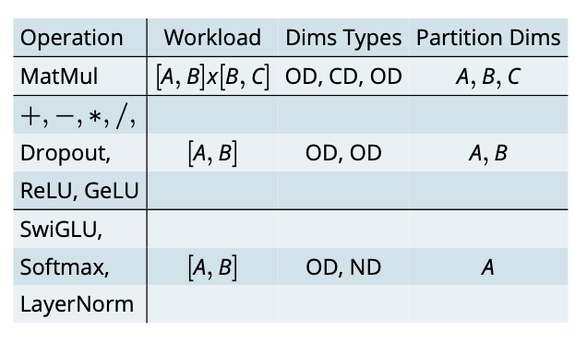
Centauri-Workload Partition
Takeaway：
Pick up a chain of dependent operations.
Compatible partition dimensions within the chain.
CD: Contraction dimensions of operations
like MatMuls and Einsums.
ND: Coupled computation along this dimension and is not preferable for splitting.
OD: This type encompasses the remaining workload dimensions.

Slide 12
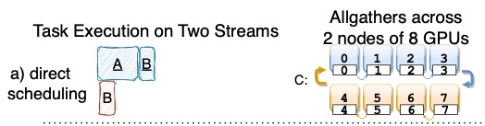
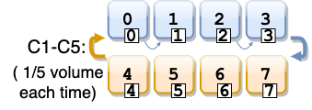


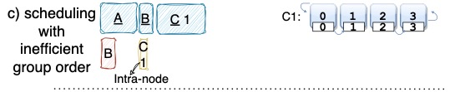
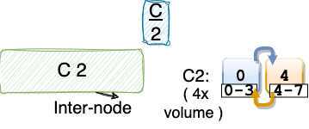

Centauri-Operation Level Scheduling
Takeaway:
Larger granularity is better.
Control the workload on low bandwidth group.

Slide 13
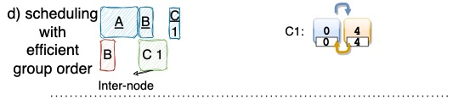
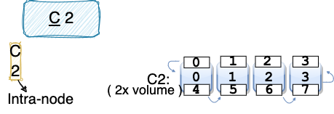
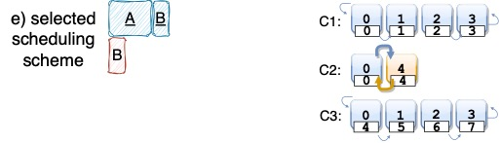



Centauri-Operation Level Scheduling
Takeaway:
Larger granularity is better.
Control the workload on low bandwidth group.
Interleaved intra- & inter- node communication scheduling.

Slide 14

Centauri-Layer Level Scheduling
Two Types of Computation
In the Backward Phase:
Activation Gradient
Weight Gradient

Slide 15
Centauri-Layer Level Scheduling
In Megatron, activation gradient is scheduled ahead of weight gradient for SP activation commucation overlapping.
These two critical paths are dynamically scheduled to maximize overlapping.

Slide 16
Centauri-Model Level Scheduling
( 4x activation memory)
4 chunks are not enough for fully overlapping.

Slide 17
Centauri-Model Level Scheduling
( 4x activation memory)
( 16x activation memory)
16 chunks result in unnecessary memory consumption.

Slide 18
Centauri-Model Level Scheduling
( 4x activation memory)
( 16x activation memory)
( 8x activation memory)
Minimal activation memory for maximal overlapping.

Slide 19
Evaluation-Setting
Model and parallel methods:
  4 sizes LLaMA on FSDP, DP, FSDP+DP, and PP+DP+PP with bf16 precision
Two A100-80G GPU clusters with 600 GB/s NV-Switch:
  Cluster A: 25 Gb/s inter-node bandwidth per device
  Cluster B: 100Gb/s inter-node bandwidth per device
Baselines:
  Megatron-LM with Zero1,2,3
  PyTorch DDP
  OOO back-propagation

Slide 20
Evaluation-Single Parallelism
Performance of FSDP/Zero3 tasks on 2 nodes of Cluster A, with FSDP group size 16.
Larger batch lead to better overlapping with over 1.40x speedup.
Performance of DP tasks on
2 nodes of Cluster A, with DP group size of 16.
Larger batch lead to better overlapping with up to 1.45x speedup.

Slide 21
Evaluation-Hybrid Parallelism
Performance of FSDP+DP tasks on 6 nodes of Cluster A, with a total group size of 48.
Performance of TP+PP+DP tasks on 6 nodes of Cluster A, with a total group size of 48 and total gradient accumulation steps of 6.

Slide 22
Evaluation-Scalability
Achieve good scalability on FSDP
FSDP16+DP: All cases suffer from a drop when DP
is employed with multi-stream communication.

Slide 23
Evaluation-FSDP Case Study
The theoretical speedup upper bound is min{ 1/$α$ , 1/(1- $α$) }.

Slide 24
Thanks!

